Slide 1

AI and Covid - Presentation 5
Prof. Dr. Maria A. Wimmer, wimmer@uni-koblenz.de
Dr. Ulf Lotzmann, ulf@uni-koblenz.de
http://www.uni-koblenz.de/agvinf/
SoSe 2022

Slide 2
Team Members:
Irshad Hussain Mohammed
Manpreeth Vankadara
Nirav Satani
Pavan Kumar Tokachichu
Pavan Kumar Reddy Kancharla
Peram Navachandu Reddy
Ramesh Reddy Modulla
Rehan Ali Syed
Sudheer Kumar Gandham
Venkata Satya Aditya Jagarlapudi

Slide 3
Incidence Response Model for Global Pandemics

Slide 4
Team Managers
11 July - 31 July
Irshad Hussain Mohammed
Peram NavaChandu
1 Aug - 24 Aug
Pavan Kumar Reddy Kancharla
Pavan Kumar Tokachichu
25 Aug - Sep 16
Aditya Jagarlapudi
Manpreeth Vankadara

Slide 5
Agenda For The Meeting
Updated Gantt Chart
Implementation
Algorithm Results
Draft Model Review
Tableau Dashboard Overview

Slide 6
Implementation
Trained data from Nov 1 to Dec 23 with Tine series Algorithm
The window size for consideration is 20 days
Predicts the next 10 days
Calculate the incidence rate based on the predicted cases
Incidence rate = cases/(population x timeframe)
Cluster regions based on Incidence Rate.

Slide 7
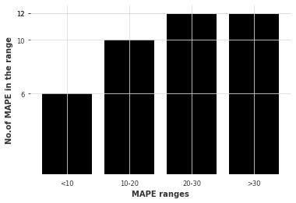
Results of Algorithms - VARIMA

Slide 8
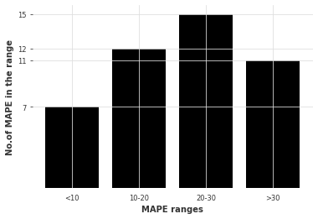
Results of Algorithm - DeepAR

Slide 9
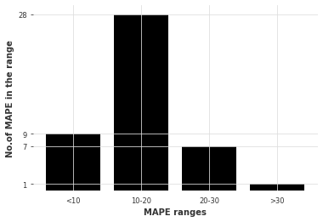
Results of Algorithm - LSTM

Slide 10
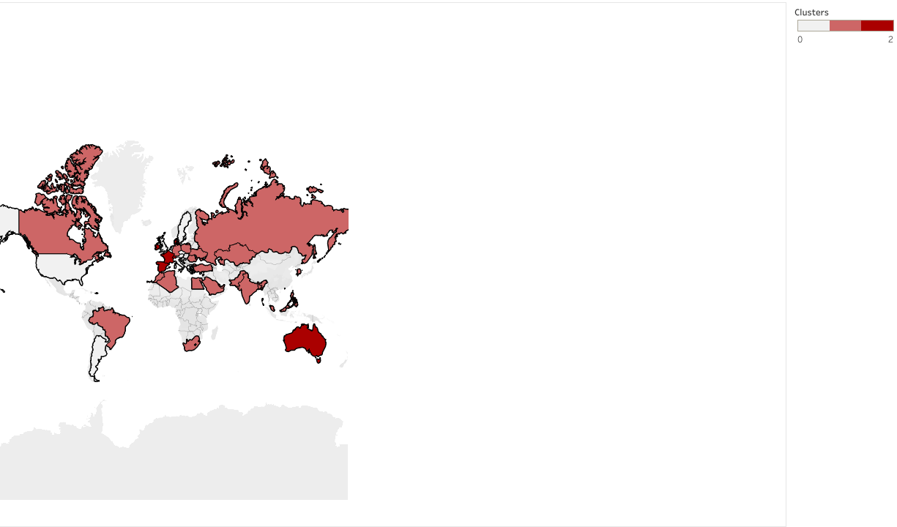
Dashboard

Slide 11
Thank You

